Slide 1



Beginner’s Guide to PCB Designing
25 March 2021
Venue: Google Meet

Slide 2
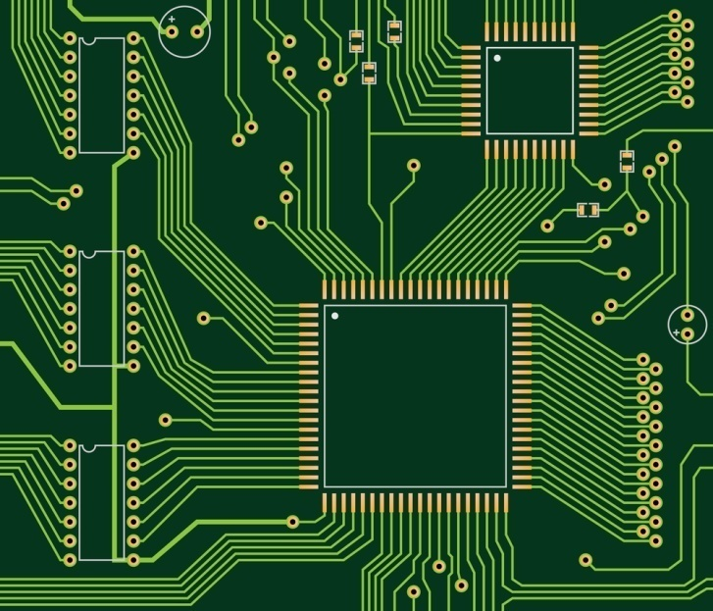


What is PCB?

Slide 3
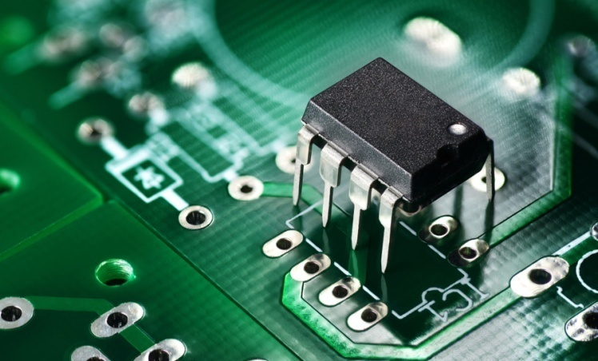
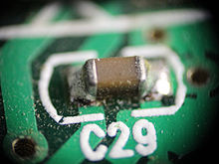
What is PCB?
DIP Components (Dual In-line Package)
SMD Components (Surface Mounted Device)

Slide 4
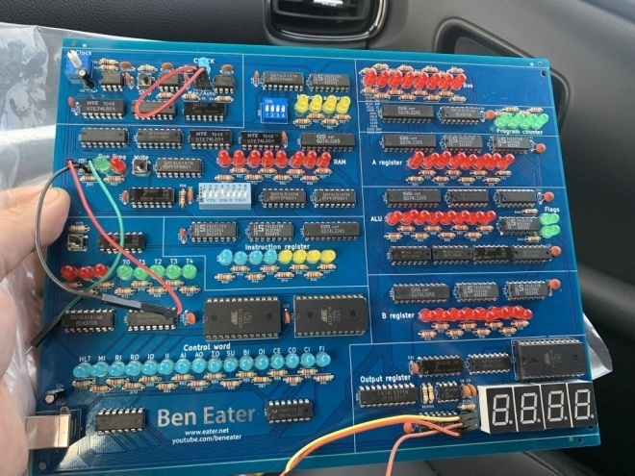
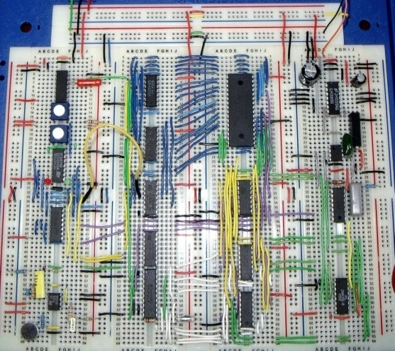
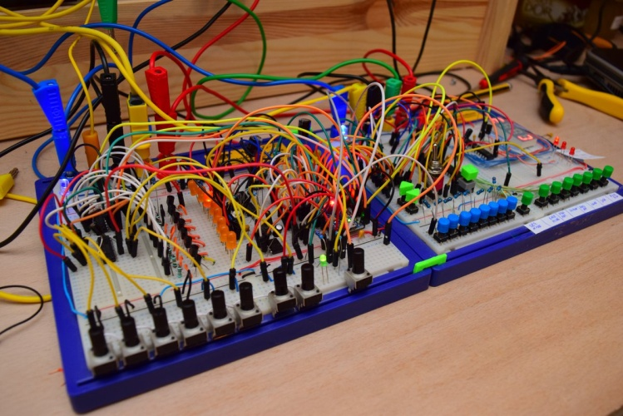
Why Design PCB?

Slide 5
Things to consider
Modularity
Compactness
Reliability

Slide 6
Design Software
Autodesk Eagle
Solidworks PCB
Proteus
NI Multisim & Ultiboard
Cadence Allergo
Altium Designer
and much more!

Slide 7

Proteus Design Suite
Circuit Simulation
PCB Design
Microcontroller simulation (VSM)

Slide 8
THANK YOU !!

